Slide 1

FIN-BOT :
AN INTERACTIVE FINANCE - CHATBOT
NAME : ASHWATHY RATHEESAN
CLASS : 3 MDS B
REG. NO. : 2348412

Slide 2
TABLE OF CONTENTS
01
04
INTRODUCTION
SAMPLE CODE
02
WORKING OF THE MODEL
05
OUTPUT AND INSIGHTS
03
06
SAMPLE DATA
REFERENCES

Slide 3
01.
INTRODUCTION TO FIN-BOT

Slide 4
02. WHAT IS FINBOT?
The Java project presented here is a chatbot designed to facilitate interactive conversations with users, categorize their queries, and provide relevant responses. The purpose of this project is to demonstrate the integration of natural language processing (NLP) techniques and concepts to create a functional conversational agent.

Slide 5
SCOPE AND SIGNIFICANCE
By demonstrating the integration of NLP techniques and machine learning concepts in a Java environment, it provides insights into building functional chatbot applications capable of understanding user intent and providing contextually relevant responses. Also it includes :
User Interaction
NLP Integration
Categorization
Loan Interest Calculation
Loan Approval Prediction

Slide 6


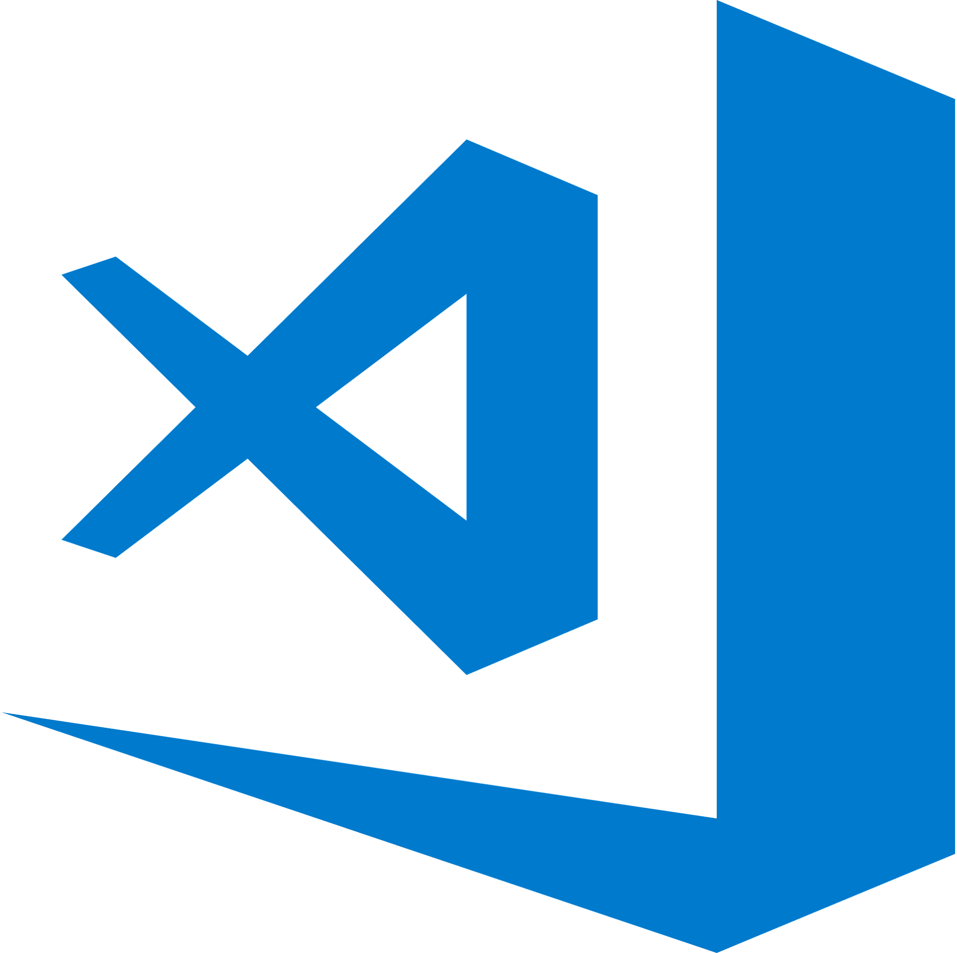
MAJOR REQUIREMENTS
VS CODE JAVA OPENNLP

Slide 7
WORKING OF THE MODEL
CSV Data: Loads data from a CSV file containing questions, content, and categories.
OpenNLP: Utilizes OpenNLP (TokenizerModel) for tokenization of user input.
Loan Interest Calculation: Computes loan interest based on principal, rate, and term.
Loan Approval Prediction: Predicts loan approval based on user input features.
Category Matching: Matches user input tokens to predefined categories for responses.

Slide 8
03. SAMPLE DATA
CONTENT
01
02
03
QUESTION
CATEGORY
Definitions of each questions are stored in the corresponding column
The first column of the data is filled with questions related to finance and investments.
Every row is then tagged with a category name.

Slide 9
CSV FILE FORMAT
question,content,category What are stocks?,"Stocks also known as equities represent ownership in a company. When you buy a stock you're buying a small piece of the company's assets and earnings potential. Stocks can offer high returns but come with higher risks. It's important to research and understand the companies you're investing in before buying their stocks.",stocks What are bonds?,"Bonds are debt securities where you lend money to an entity typically a corporation or government for a fixed period at a fixed interest rate. Bonds are considered safer investments compared to stocks because they provide regular interest payments and return the principal amount at maturity. However bond prices can fluctuate based on interest rates and credit risk.",bonds How to save money?,"Saving money regularly is crucial for financial stability and emergencies. Whether it's setting aside a portion of your income each month or cutting back on unnecessary expenses developing a savings habit can help you achieve your financial goals. Consider automating your savings contributions and keeping track of your expenses to stay on target.",savings How to create a budget?,"Creating and sticking to a budget is essential for managing your finances effectively. Start by tracking your income and expenses to understand where your money is going. Then set realistic spending limits for different categories such as housing transportation groceries and entertainment. Review your budget regularly and make adjustments as needed to stay on track.",budget What are mutual funds?,"Mutual funds pool money from multiple investors to invest in a diversified portfolio of stocks bonds or other assets. They offer investors access to professional management and diversification. Mutual funds can be actively managed where fund managers actively buy and sell securities or passively managed where they aim to replicate the performance of a specific index.",mutual funds

Slide 10
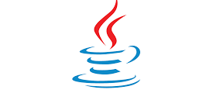
04.
JAVA CODE

Slide 11
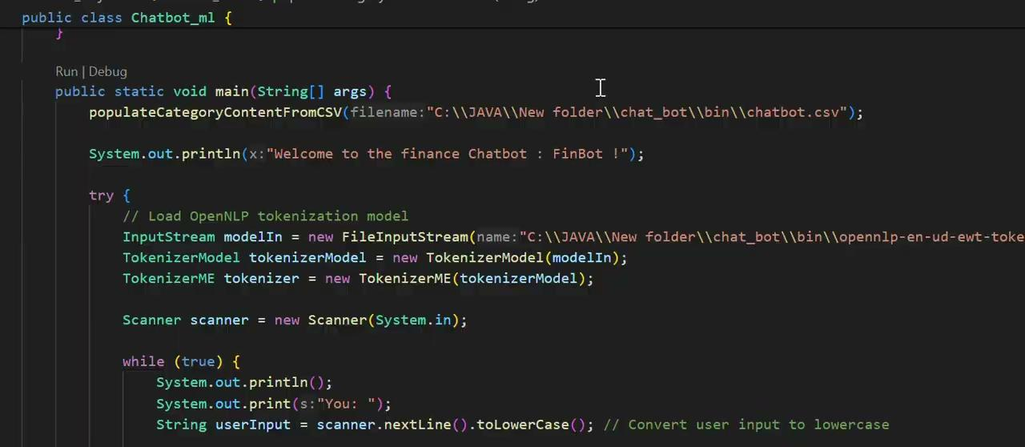

Slide 12

05.
OUTCOME

Slide 13


Slide 14
CONCLUSION
In conclusion, the Java project resulted in the creation of a functional finance chatbot capable of performing tasks such as loan interest calculation and approval prediction. The main findings and outcomes include:
Functional Chatbot:
The project successfully implemented a chatbot capable of understanding user queries, tokenizing input using OpenNLP, and providing appropriate responses based on predefined categories.
Finance Features:
Specific finance-related functionalities were integrated, allowing users to calculate loan interest and predict loan approval based on user-provided information.
Insights into NLP:
The project provided insights into natural language processing (NLP) techniques, particularly text tokenization using OpenNLP, and their application in developing conversational agents.

Slide 15
06. REFERENCES
Investopedia: https://www.investopedia.com/investing-4427685
NerdWallet: https://www.nerdwallet.com/h/category/savings-accounts?trk=nw_gf_5.0
NLTK(NaturalLanguageToolkit)documentation: https://readthedocs.org/projects/nltk/downloads/pdf/latest/
OpenNLP documentation:https://opennlp.apache.org/docs/
OpenNLP API Javadoc: https://opennlp.apache.org/docs/1.9.3/apidocs/

Slide 16
THANK YOU

